Slide 1
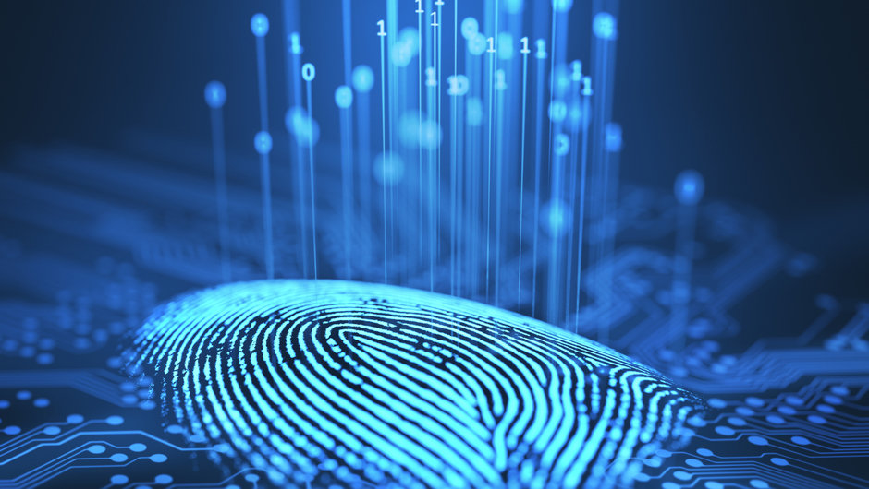
BIOMETRICS
Vishal M. Nimbolkar
ID – 17CM031

Slide 2
Contents :
What is Biometric ?
Categories of Biometric ?
Problem with current security system.
Working principle
Fingerprint recognition
Application
Benefits
Conclusion

Slide 3
What is biometric :
The term “Biometrics” is derived from the Greek word bio(life) and metric(to measure).
Biometric is he identification or verification of human identity through the measurnment of repetable physiological and behavioural characteristics.

Slide 4
Categories of biometrics
Biometrics can be sorted into two classes:
PHYSOLOGICAL: It is related to the shape of the body.
ex.- face, fingerprints, hand geometry and iris recognition, dna.
BEHAVIORAL: It is related to the shape of the person.
ex.- signature and voice

Slide 5

Problems with current security system
based on password, id / swipe card
Can be lost
Can be forgotten
Worse! Can be stolen and used by a thief/intruder to access your data, bank account, car etc..

Slide 6
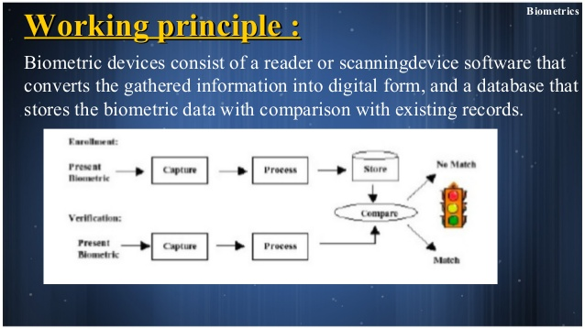
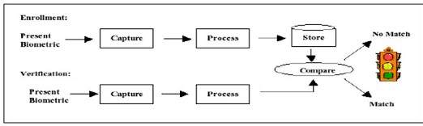

Slide 7
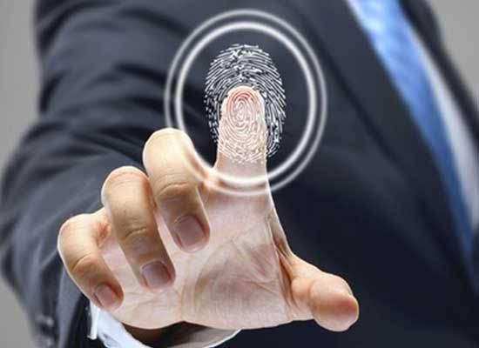
FINGERPRINT RECOGNITION
It is refer to the automated method of identifying or confirming the identity of an individual based on the comparison of two fingerprints.
Fingerprint recognition is one of the most well known biometrics, and it is by far the most used biometric solution for authentication on computerized system.

Slide 8
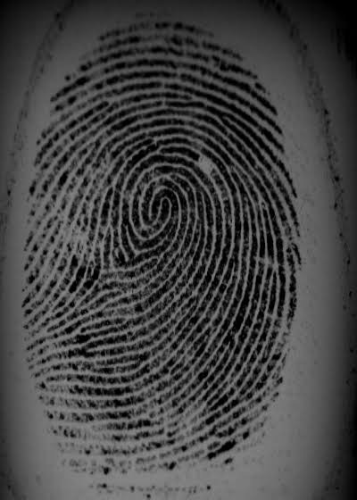
a
Fingerprints are distinguished by Minutiae , which are some abnormal points on a ridge.
The most prominent local ridge characteristics , called minutiae , are
1. ridge ending and
11. ridge bifurcation.
A fingerprint image acquired by an optical sensor.

Slide 9


minutiae
Ridge :
Valley :
A ridge ending is define as the point where a ridge ends abruptly.
A ridge bifurcation is define as a point where a ridge or diverges into branch ridge called as valley.

Slide 10
How the recognition done ?
THE FINGERPRINT RECOGNITION PROBLEM CAN BE GROUPED INTO TWO SUB- DOMAINS :
Fingerprint verification :
fingerprint verification is to verify the authenticity of one person by his fingerprint.
Fingerprint identification :
fingerprint identification is to specify one person’s identity by his fingerprint.

Slide 11
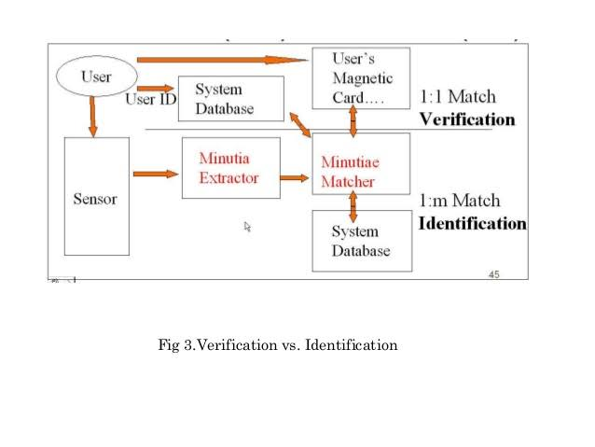

Slide 12
Benefits :
Increased security measures
Reduce cost of password & ID cards maintenance
Ability to rack employees and link activities
No password to forget
Elimination of problems such as lost/stolen identification card and PIN numbers
Faster login time
Improved security of sensitive information

Slide 13
application
Computer logins
ATMs
Grocery stores
Airport kiosks
Driver’s licenses
National ID cards
Internet banking
Welfare disbursement
International border crossing
Forensics- Criminal Identification

Slide 14
Conclusion :
Multi biometric system have a huge potential of growth.
Access procedures are made simpler , faster and more secure
Especially governments , low enforcement agencies , military and industrial companies , already make partial use of this technology.
I the future biometric devices will surely become more involved in many civil areas.

Slide 15


