Slide 1
Computer vision
Creating artificial life

Slide 2
Contents :
Introduction
What is computer vision
Need of these technology
Application

Slide 3
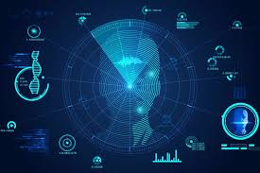
Introduction ~
Computer vision is an interdisciplinary scientific field that deals with how computers can be made to gain high-level understanding from digital images or videos.

Slide 4
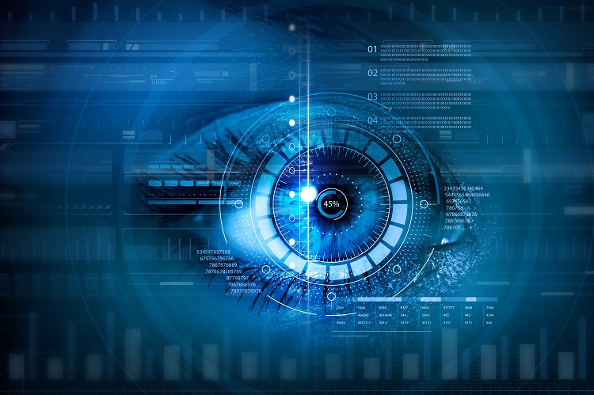
Computer generally use vision as their primary means of sensing their environment, we generally see more than we hear, feel or smell or taste.
The goal of computer vision research is to give computer this same powerful facility for understanding their surrounding .

Slide 5
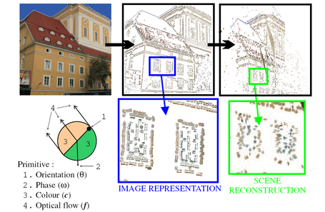
What is computer vision :
Computer vision is a field that includes methods for acquiring , processing ,
analysing and understanding images .
known as image analysis,
scene analysis, image
understanding.

Slide 6
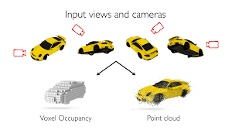
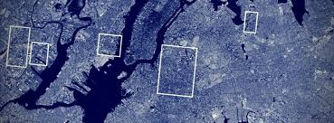
Duplicate the ability of human vision by electronically perceiving and understanding of image .
Theory for building artificial system that obtained information from images.
Image data can take forms , such as a video sequence ,depth images, views from multiple cameras , scanners , satellite sensors etc.
Multiple cameras
Satelite sensor

Slide 7
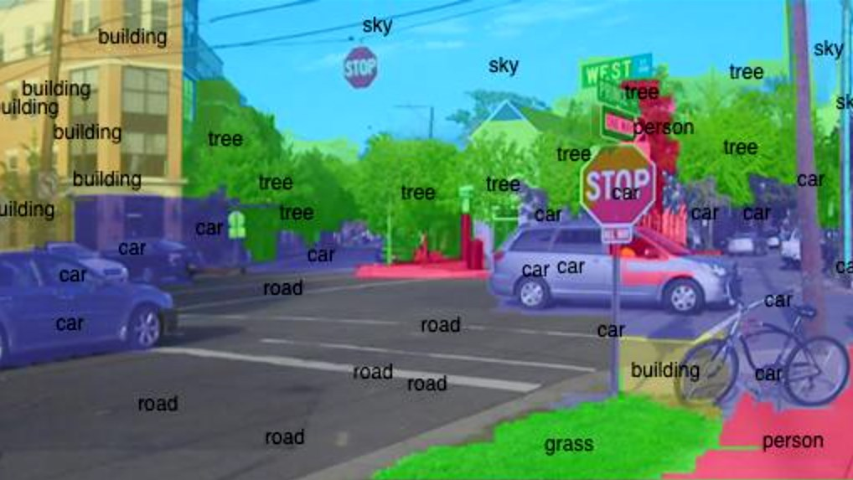
A computer can look at the image and
see nothing, if we deem it so, but with
computer vision it can recognize and identify
all the faces, tell you the ages of everyone in
the picture, and even accurately tell you
everyone’s ethnicity. It may have a harder
time determining the season and time of day,
due to the shadows, lighting, and shapes,
but when it comes to the crowd analytics,
verification and recognition it is a breeze.

Slide 8
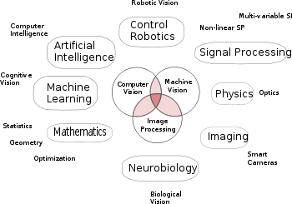
Computer Vision is an overlapping field drawing on concepts from areas such as artificial intelligence, digital image processing, machine learning, deep learning, pattern recognition, probabilistic graphical models, scientific computing and a lot of mathematics.

Slide 9
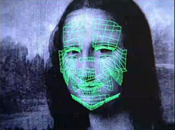
The computer vision~
It’s an ability of a machine to extract information form an image that is necessary to solve a task.
Image acquisition
Image processing
Image analysis
Image understanding

Slide 10
What IS THE NEED OF COMPUTER VISION :
Smart video surveillance
Biometric
Automatic driver assistant system
Image retrieval
Machine vision
Movie production
Robotics

Slide 11
The applications of computer vision:
Target recognition
Traffic monitoring
Face detection
3D shape reconstruction
Sports
Smart cars
Medical imaging
Navigation

Slide 12
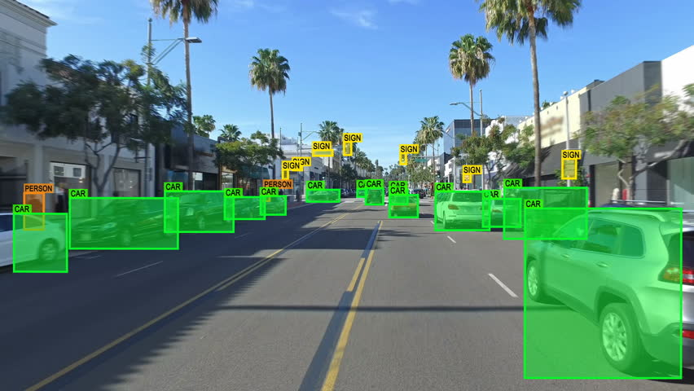
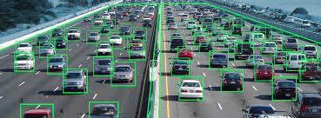
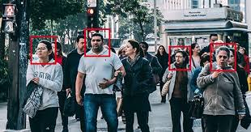
Target recognition :
Traffic monitoring:
Face detection:
Target recognition is the ability for an algorithm or device to recognize targets or other objects based on data obtained from sensors.
Computer vision uses algorithm for detection of foreground and is capable of tracking the vehicle trajectory and extracts the useful traffic information for vehicle counting.
Detect the presence of human faces, if any.
Extract info about the coordinates and size of those human faces.

Slide 13
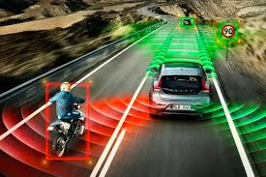
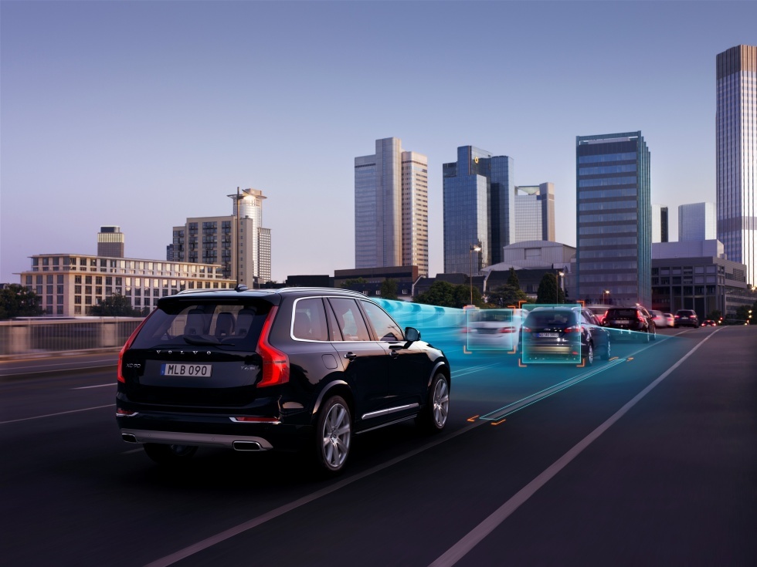
Driverless car by computer vision~
This is the example of Driverless car.
Driverless car use the machine vision
algorithms to drive itself by sensing its
environment and navigation without
human input. It can detect surroundings
using technics like computer vision. It
automatically operates the steering
wheel, brakes, accelerator to drive Much
same way as person would drive.

Slide 14
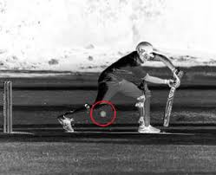
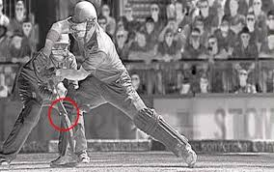
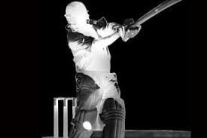
This is how the decision can be take by hotspot . But sometimes it is difficult to take decision by the hotspot DRS(decision revieve system). It increases more complication during recognizing, and sometimes it take a wrong decision.
By using computer vision…

Slide 15
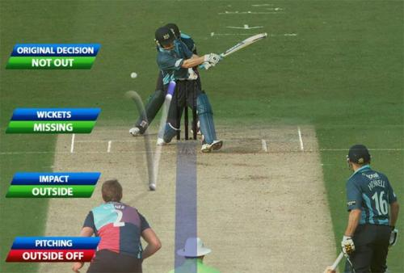
Computer vision in gaming :
It uses a computer vision based technology
to track the trajectory of the ball. It is
deployed by a number of high speed
cameras around the field of play. The
imagery from each of the cameras is
used to determine the 2-d coordinates
of the ball. Now the 2-d data is combined
with the relative placements of the cameras
to generate a 3-d model for the ball’s
trajectory.

Slide 16
So, there is a big need of the computer vision it makes a life easiear.
Thanks…

