Slide 1
INTRODUCTION
“ Water is life” in true sense. The word has meaning , Every living being required water and air for their survival.
Like wise plants , crops also required water.
The only source of water is rain which fulfil this demand. In India the monsoon is not so faithful. Sometime there may be heavy rain causing floods which distort and damage crops and sometimes there may not be rain at all creating scarcity of water for crop.
to overcome these difficulties , there is need of implementing various method and measures to store water during a period of excess rainfall and to use that water during period of no rainfall or less rainfall.

Slide 2
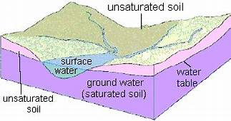
GROUND WATER
What is meant by ground water.
water that collects or flows beneath the earth surface , filling the porous spaces in soil, sediments and rocks called GROUND WATER.
Ground water originates from rain and from melting snow and ice and is the source of water for aquifers, springs, and wells. The upper surface of ground water is known as water table.

Slide 3
GROUND WATER TABLE
The depth of water , below the surface of the earth is called ground water table.
India extracts more ground water than any other country in the world. India accounts for 25% of the words extracted groundwater, morethan next two countries, Chania and United States.
DECLINE OF GROUND WATER
Punjab = 84 %
Uttar Pradesh = 83 %
Jammu and Kashmir = 81 %
Delhi, Haryana,
Chandigarh,
Himachal Pradesh
& Uttarakhand = 70 to 80 %
Rajasthan = 49 %
Maharashtra &
Madhya Pradesh = 53 to 59 %

Slide 4
GROUND WATER DECLINE AND DEPLETION
The water stored in the ground can be compared to money kept in bank account. If you withdraw money at a faster rate than you deposit new money, you will eventually start having account supply problems.
Pumping water out of the ground faster than it is replenished over the long term causes similar problems. The volume of ground water in storage is decreasing in many areas of the United States in response to pumping.
EFFECTS OF GROUND WATER DEPLETION
Drying up of wells
Reduction of water in streams and lakes
Increasing pumping cost
Land subsidence, etc.

Slide 5
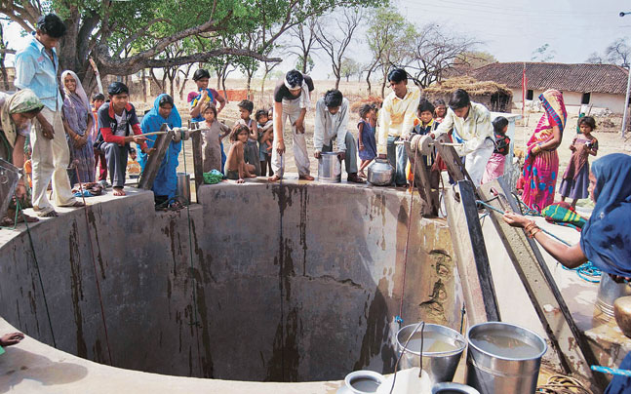
IMPORTANCE OF GROUND WATER IN INDIA
India is the agrarians country, The maximum crops depends on seasonal rainfall. Therefore it is very necessary to maintain ground water table.
Ground water is the main source of drinking water in both Urban and Rural areas. It also important source for industrial sector.
In monsoon, if rain occur, water flows on the surface of the earth in the form of flood and meet to the ocean and becomes unusable.
So that, to increase the ground water table, it is very necessary to stored or to stop flooding of water by applying various methods of ground water recharging.

Slide 6
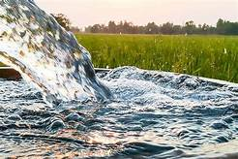
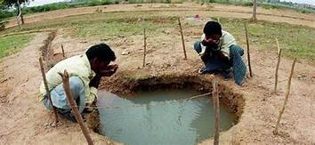
BENEFITS OF GROUND WATER RECHARGING
Ground water recharging has a number of advantages, including
Lower permitting, construction and operation cost.
Less water loss to evaporation.
Less effort use to extracts ground water from well,
Greater distribution across the state.
Good quality of water
Increase in production and there will be rising up GDP of country.

Slide 7
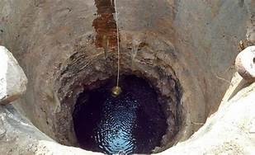
WHY INDIA DOES NOT HAVE ENOUGH WATER TO DRINK
In India , scarcity of water is occur due to following reasons
Over exploitation of water :
India is biggest users of ground water. Ground water meets more than half of total requirements of clean water in the country.
Extraction of ground water in India
Irrigation
Household Use
Industry
89 %
9 %
2 %

Slide 8
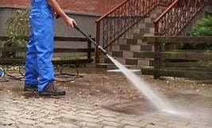
2 . Wastage of water
India captured only 8% of annual rainfall.
India has been also poor in treatment and re-use household waste water.
Due to above condition, more amount of water is waste.
3 . Unequal distribution and availability :
Varying intensity of rainfall and different ground water table in different areas of the states, there may be problem to distribute equal water to drink.

Slide 9
METHODS OF GROUND WATER RECHARGING
There are many methods of ground water recharging followed by Municipal Department
Some methods are as below-
Method : 1. SPREADING BASINS
This method involves surface flooding of water in basins that are excavated in existing terrain .
For effective recharge , highly permeable soil are suitable and maintenance of a layer of water over the highly permeable soil is necessary.
At the surface of aquifer, closing occurs by deposition of particles carried by water in suspension or in solution, by algae growth, swelling and soil dispersion, etc.
Recharge by spreading basin is most effective where there are layer below the land surface and the aquifer and where clear water is available for recharge.

Slide 10
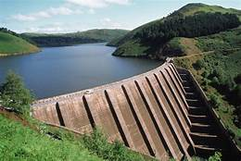
METHOD : 2 . SURFACE DAM
Ground water moves from higher pressure head to lower one. This will help in semi- raised zone
regions especially in upper reaches where the ground water velocity is high.
By exploiting more ground water in upper reaches more surface water can be utilized indirectly, there by reducing inflow into lower reaches of supply.
Ground water is stored in natural aquifer materials in sub-surface dam or in artificial sand storage dam.

Slide 11
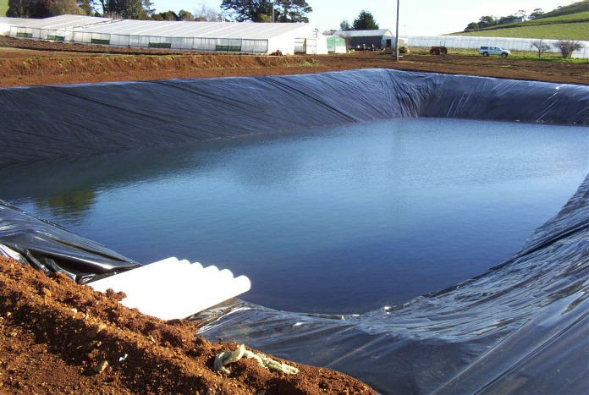
METHOD : 3 . FARM PONDS.
There are traditional structure in rain water harvesting. Farm ponds are small storage structure collecting and storing runoff waste for drinking as well as irrigation purpose.
As per the method of different topography conditions farm plants are classified into two categories.
Selection and location of farm pond depends on several factor such as rainfall, land topography, soil type, texture, permeability, water holding capacity, land use pattern, etc.
Farm Pond
Excavated Pond
( Suited for flat topography )
Embankment pond
(Suited for hilly terrain )

Slide 12
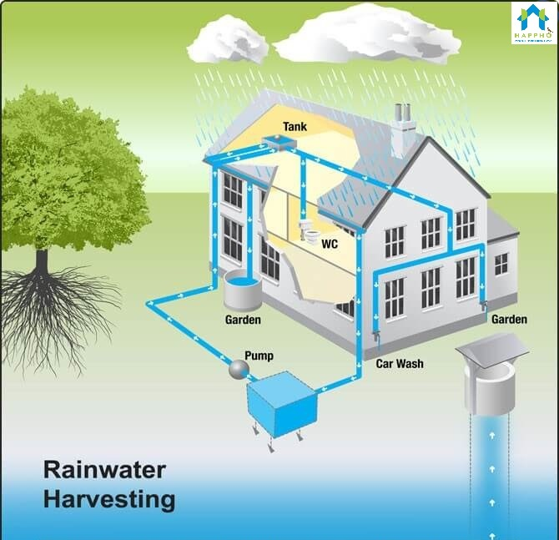
METHOD : 4 . ROOF TOP RAINWATER HARVESTING
This is very simple method for recharge ground water .
Rain water harvesting is a technique of collection and storage of rainwater into natural reservoir or tanks, or the infiltration of surface water into subsurface aquifers.
In Roof Top Rain Water Harvesting most any surface – tiles, metal sheets, plastics, palm leaf – can be use to intercept the flow of rainwater and provide these water to household with high quality drinking water and year round storage. Other uses include water for gardens, irrigation purpose, etc.

Slide 13
CONCLUSION :
“Water is life”
Thus it can be concluded that, when application of different methods to ground water recharge it gives
protection from scarcity of water,
reducing water supply demand and distribution ,
protect the farmers from land subsidence,
there will be more availability of water in aquifers,
lower in constructing and operation cost, etc.
Therefore it is very necessary to save water & stored it .

