Slide 1
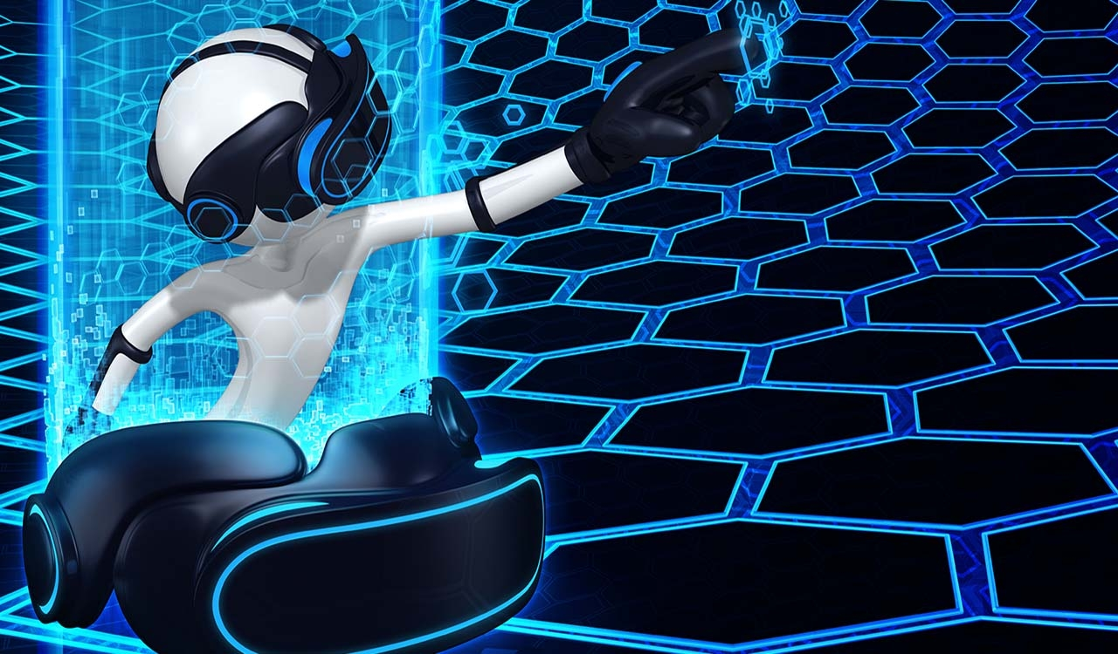
HAPTICS TECHNOLOGY

Slide 2
Containts
What is haptics tecnology?
How it works?
Haptics information
Haptics devices
Applications
Advantages
Limitations
Conclusion

Slide 3
What is Haptics?
Haptic is technology of adding the sensation of touch and feeling to computers.
A haptic device gives people a sense of touch with computer-generated environments, so that when virtual objects are touched, they seem real and tangible.
Haptic senses links to the brains sensing position and movement of the body by means of sensory nerves within the muscles and joints.

Slide 4
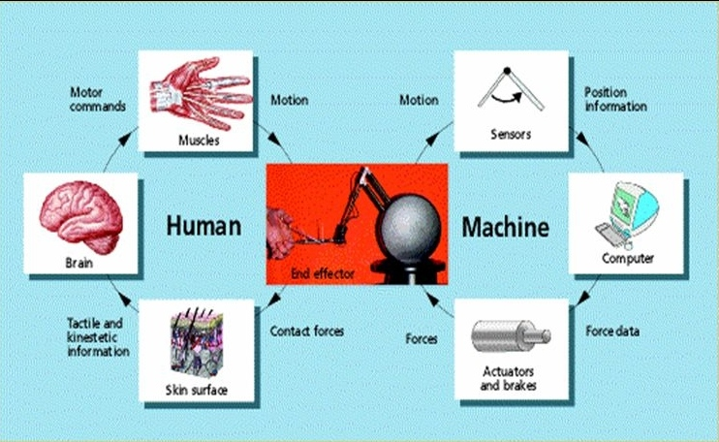
How it works?

Slide 5
Haptics information
Basically the haptics information provided by the system is the combination of:
Tactile information
it refers to the information acquired by the sensors which are actually connected to the skin of the human body.
Kinesthetic information
it refers to the information acquired through the sensors in the joints.

Slide 6
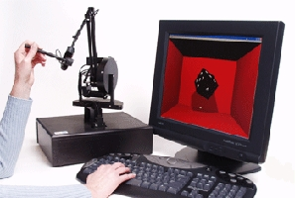
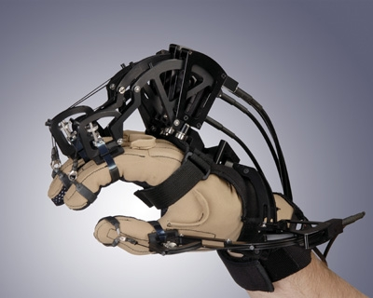
Haptics devices
Commonly used haptics interfacing devices
1)Phantom 2)Cyber Glove

Slide 7
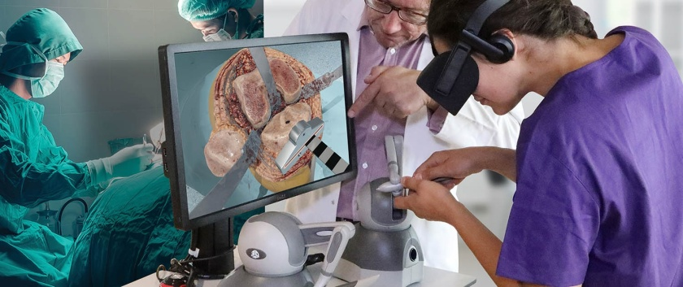
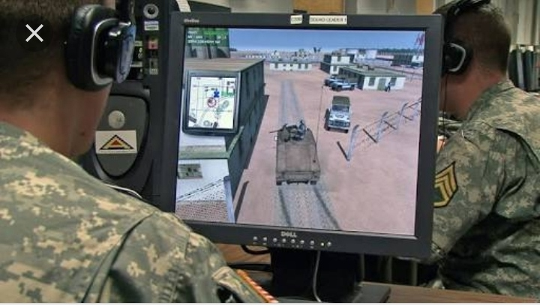
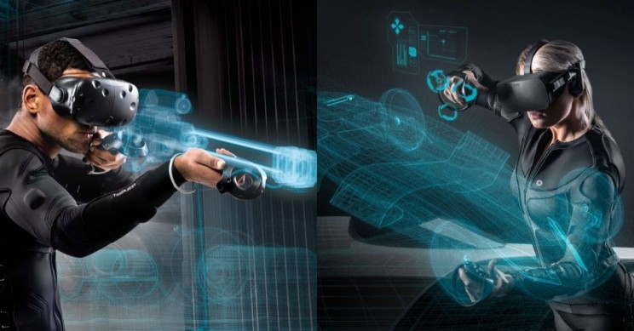
Aplications
Medical
Military
Gaming

Slide 8
Advantages
Communication is centered through touch and the digital world can behave like real world.
Increase confidence in medical field.
With haptic hardware and software designer can feel the result as if he were handling physical objects.
Working time is reduced.

Slide 9
Limitations
High cost
large weight and size of haptic devices
haptic interfaces can only exert forces with limited magnitude and not equally well in all directions.

Slide 10
Conclusion
Haptic technology is the only solution that provide high range of interaction that cannot be provided by virtual reality
Haptic technology will make the future world the sensable one.
Future generations of mobile devices and game console accessories will implement more haptic feedback
Perhaps also in desktop computers and laptops

Slide 11
THANK YOU

