Slide 1

Touch Screen Technology
Touch Screen Technology

Slide 2
Objectives
Introduction
History
What is Touch Screen ?
When it is applicable?
How does it works ?
Touch Screen Technology
Application
Advantages
Conclusion
References

Slide 3

Introduction
A touch Screen is an input device that allows users to operate PC by simply touching the screen.
The display Screen has a sensitive glass placed on it and we could the desired input by touching it.
A touch screen is based on CRT (Cathode Ray Tube) technology .That accepts direct on screen input.

Slide 4
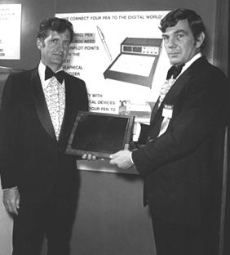
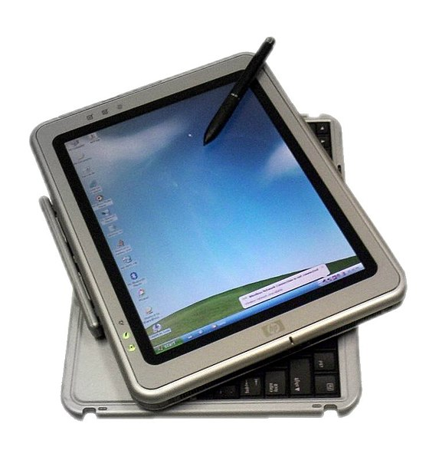
History
Historians considered the first touch screen to be capacitive touch screen invented by
E. A. Johnson in the UK around 1965 .
In 2002 Microsoft’s Windows XP Tablet

Slide 5
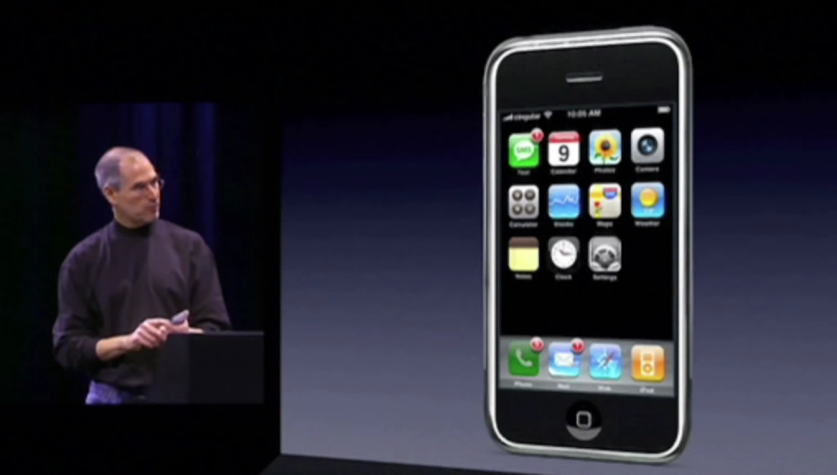
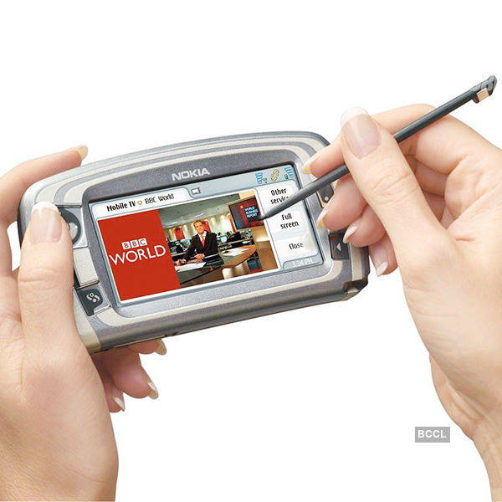
2007 Apple’s iPhone (Multi-Touch)
The Nokia 7710 is the first touch screen mobile phone model produced by Nokia .
In 1971 First touch sensor was developed by Doctor Sam Hurst.

Slide 6
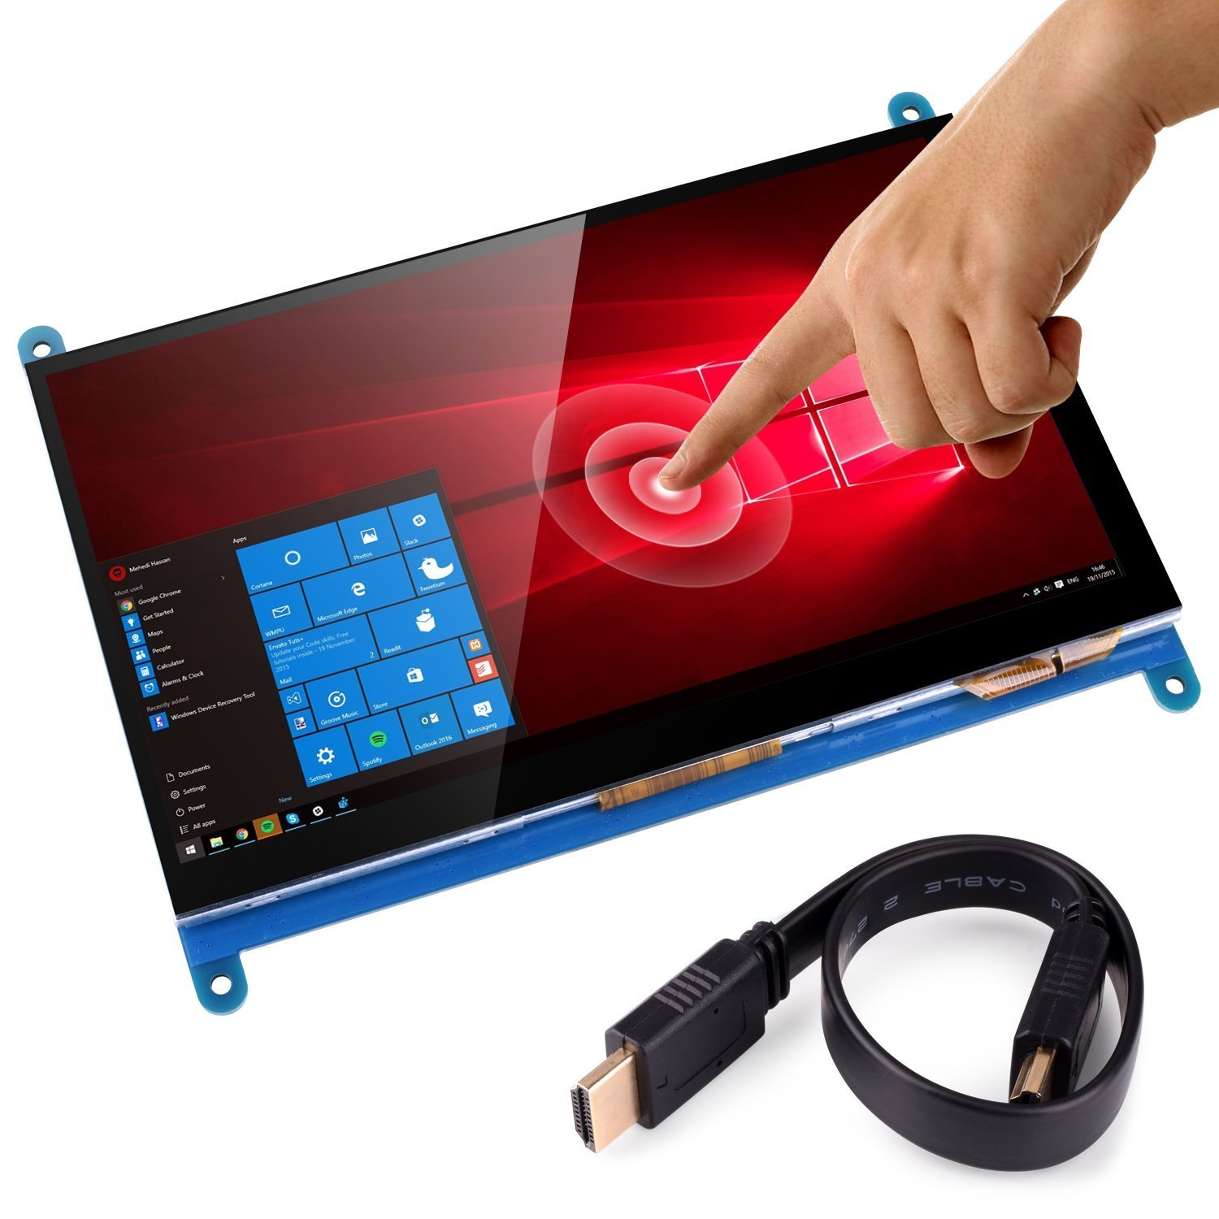
What is touch Screen ?
An electronic visual display that locates the coordinates of a users touch within display area .
Works independently of what is being displayed in screen .

Slide 7
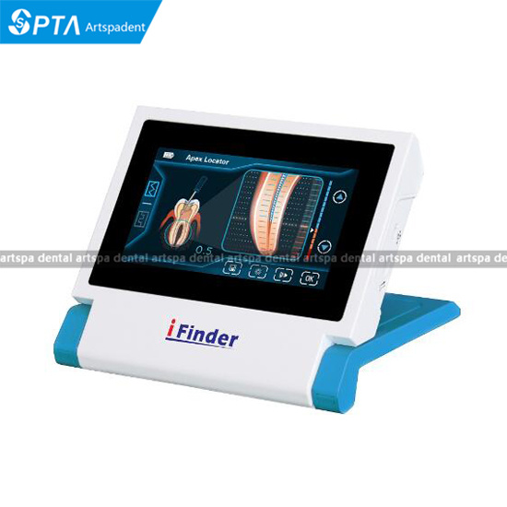
When it is applicable?
It allows users to interact directly with what is being displayed, rather than indirectly using a mouse or keyboard.
Can be used without any intermediate device.
Found in modern smart phones , video games , kiosks , navigation system , etc…

Slide 8
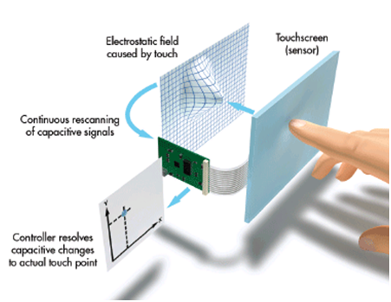
Working of touch screen technology

Slide 9
Touch Screen Technology
Four different technologies used to make touch. screens today:
Resistive
Capacitive
Surface Acoustic Wave (SAW)
Infrared LED or Optical

Slide 10
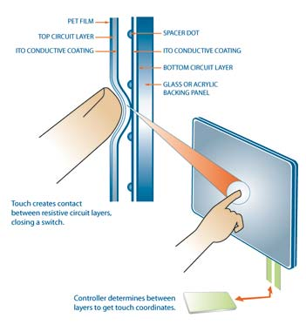
Resistive Touch Screen Technology
Two layers of conductive material
Touch creates contact between resistive layers
Voltage in circuit changes based on position

Slide 11
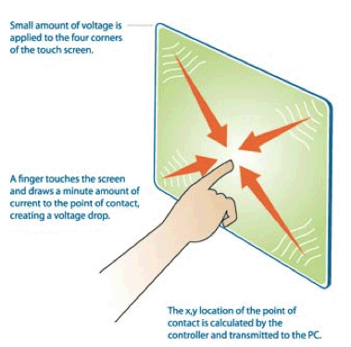
Capacitive Touch Screen Technology
Glass panel with conductive layer (Indium Tin Oxide)
Small amount of voltage applied to four corners of touch screen

Slide 12
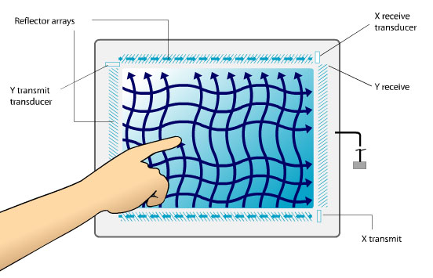
Surface Acoustic Wave Technology
Surface consists of glass
Electrical signals sent to the transmitting transducers
Waves are directed across screen by reflectors

Slide 13
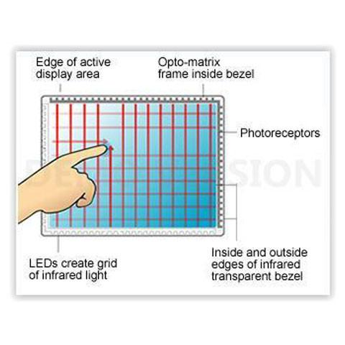
Infrared LED or Optical Technology
Uses infrared LEDs and matching photodetectors
Touching screen interrupts LEDs
Cameras detect reflected LED caused by touch

Slide 14
Advantages
Direct pointing to the objects and also fast
Finger or pen is usable
No cable or keyboard necessary
Suited to novices , application for information retrieval etc
Disadvantages
Accidentel Dialing
Accuracy and Feedback

Slide 15
Application
Gas and Fuel Stations
At Cinemas , Restaurants , Airports
In Cars
Super Markets
Gaming Systems
Home Automation system

Slide 16
Conclusion
As it is very friendly ,fast, accurate easy for the novices and fun to operate , it has been widely accepted.Today this technology is been adopted by computer mobile users of all abilities because it ia innovative , simple.In future there will be no usage of mouse and keyboards as they will be replaced by touch screens for sure.Touch Screens are popular in hospitality , and in heavy industry aas well as kiosks such as museum diaplay.

Slide 17
References
1) https://www.researchgate.com
2) en.wikipedia.org/wiki/touch-screen.
3) en.wikipedia.org/wiki/resistive touch-screen.
4) https://www.getch.education.com.
5)https://www..studymafia.com
6) https://www.touchsystem.com
7)https://www.planer.com

Slide 18

Thank You !

