Slide 1
EDGE COMPUTING

Slide 2
Contents
Introduction
What is Edge Computing?
Purpose
How it Works?
Why do we need of Edge?
Edge Computing Characteristics
Edge Computing Vs Cloud Computing
Advantages & Disadvantages
Application
Future scope
Conclusion

Slide 3
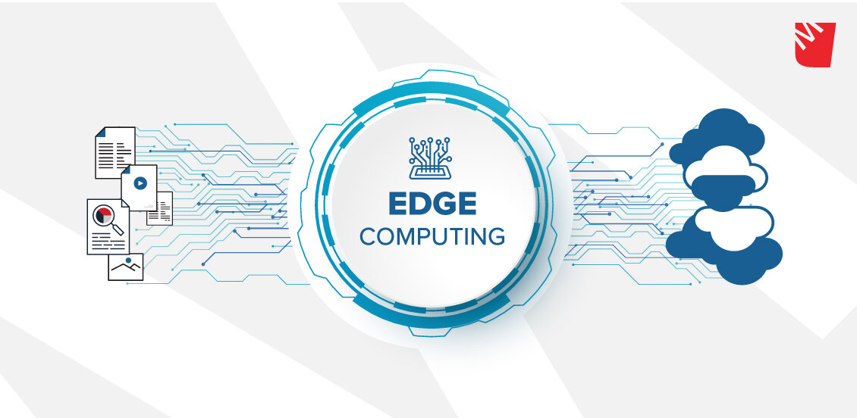
Edge Computing
Bringing the Internet closer to you…

Slide 4
Introduction
Edge computing is computing that’s done at or near the source of the data, instead of relying on the cloud at one of a dozen data centers to do all the work.
Edge computing is a distributed computing paradigm which brings computation and data storage closer to the location where it is needed.
Cloud Computing operates on big data while edge computing operates on "instant data" that is real-time data generated by sensors or users.

Slide 5
Purpose
The objective of the new technology is :
To increase data transmission rates
Spectrum Efficiency
To facilitate new applications
Increased capacity for mobile use.
To improve response times and save bandwidth

Slide 6
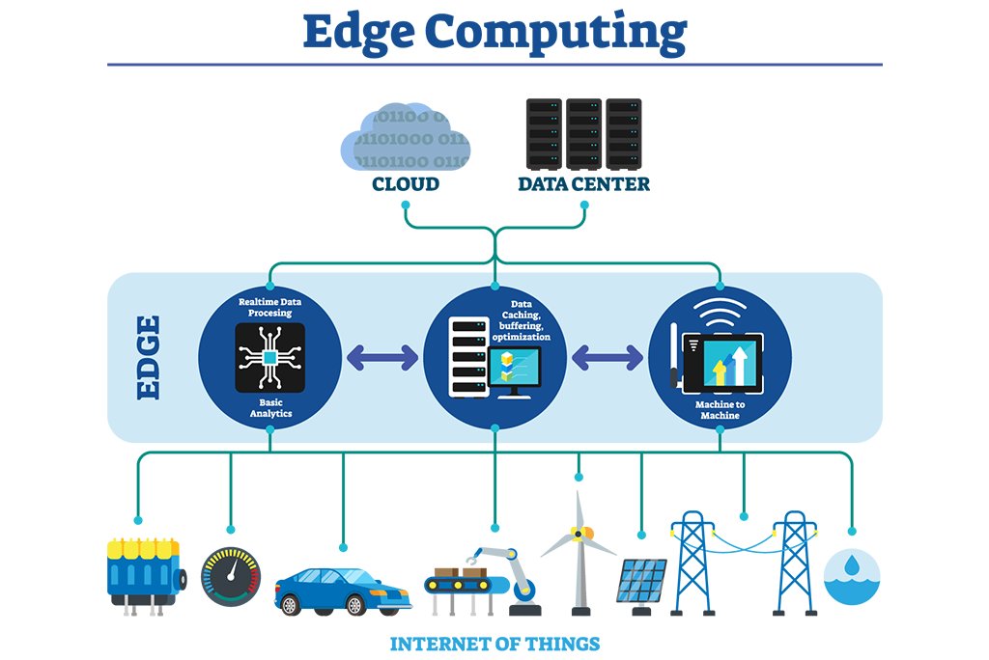
How it Works ?

Slide 7
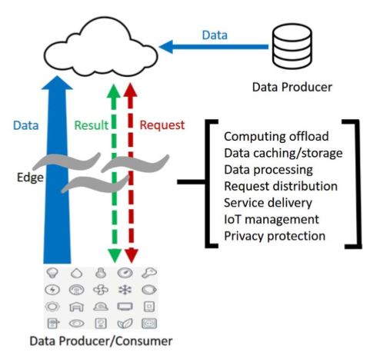
Why do we need Edge Computing ?
Push From Cloud Services
Pull from IOT
Change from Data Consumer to Producer

Slide 8
The Edge Computing Characteristics
Geographically distributed
Scalable
Autonomous and distributed
Edge computing is contextual and low latency
Real time interactions
Heterogeneous

Slide 9
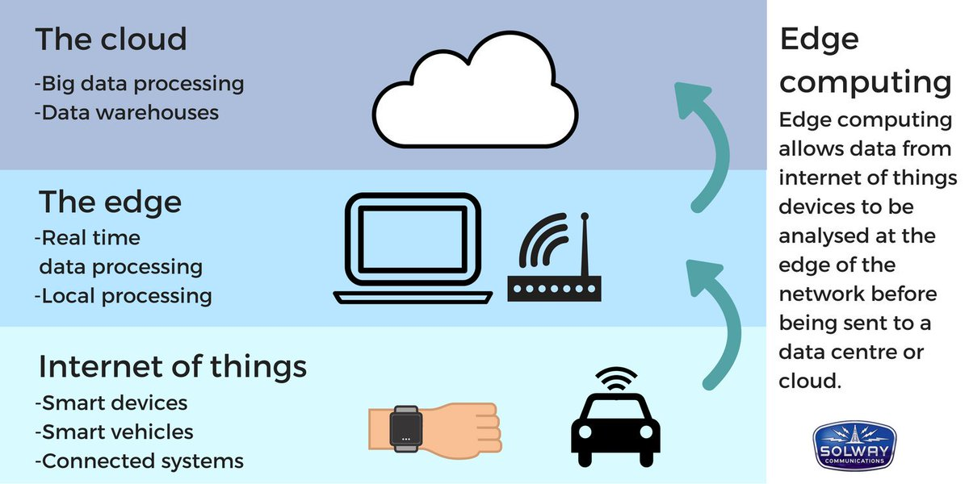
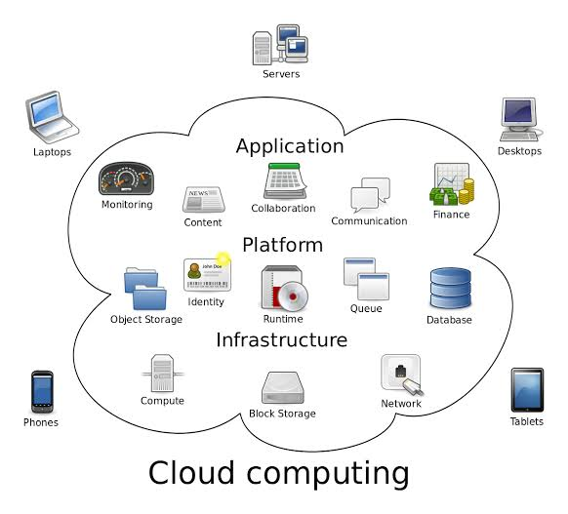
Edge Computing Vs Cloud Computing
Edge Computing
Cloud Computing
It is used to process time-sensitive data.
Service location-in edge network.
It is used to process data that is not time driven.
Service location-within the internet.

Slide 10
Advantages & Disadvantages
Advantages
Disadvantages
Low Latency
Real-Time Availability
Real-Time Data Transmission
Reliable Connectivity
Productivity Increase
No or Limited Redundancy
Potential Loss or Corruption of data
Higher risk

Slide 11
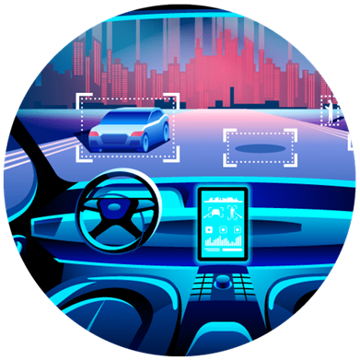
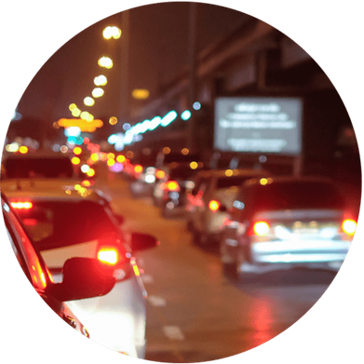

Applications
Here are four present-day examples of edge computing in action:
Edge Video Orchestration
Traffic Management
Autonomous vehicles
Mobile App Data Management

Slide 12
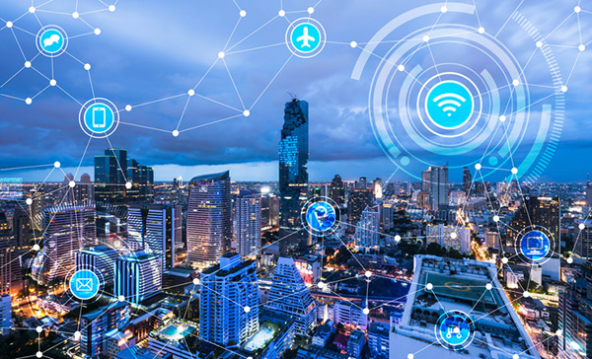
Future Enhancement for Edge Computing
The role of edge computing to date has mostly been used to ingest, store, filter, and send data to cloud systems. We are at a point in time, however, where these computing systems are packing more compute, storage, and analytic power to consume and act on the data at the machine location. This capability will be more than valuable to industrial organizations
Edge Computing: A deep dive into Edge IoT Analytics

Slide 13
Conclusion
Nowadays, more and more services are pushed from the cloud to the edge of the network because processing data at the edge can ensure shorter response time and better reliability.
That’s where both edge computing and fog computing really come in. If your data is generated at the edge in IoT, then why not bring all your intelligence and analysis as close to the edge, the source, as possible, with all the obvious benefits.

Slide 14
References
https://en.wikipedia.org/wiki/Edge-Computing [Edge computing is a distributed computing paradigm which brings computation and data storage closer to the location where it is needed]
https://www.networkworld.com/article/what-is-edge-computing
www.youtube/cEQUeltHdo [Edge computing places workloads closer to where data is created and where actions need to be taken]
https://searchdatacenter.techtarget.com/definition/edge_computing

Slide 15
Thank You !!!

