Slide 1
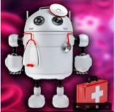
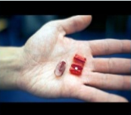
INGESTIBLE ROBOT

Slide 2
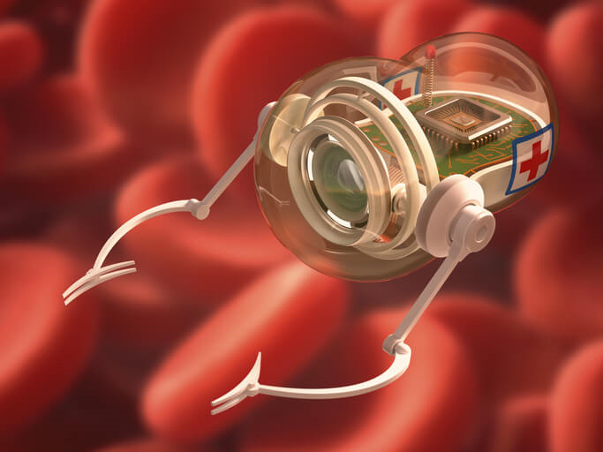
content
Introduction
Need of Ingestible Robot
Construction
Working
Mission of Origami Robot
Advantages and disadvantages
Conclusion
References

Slide 3
introduction
What is Ingestible Robot ?
A foldable origami robot which can be ingested and controlled with external magnetic fields to operate inside our body.
Origami-based robots can be ingested into the stomach, locomotive to a desired location, patch a wound, remove a foreign body, deliver drugs, and biodegrade.
Provides versatile capabilities for gastrointestinal interventions, especially when used in conjunction with imaging technologies.

Slide 4
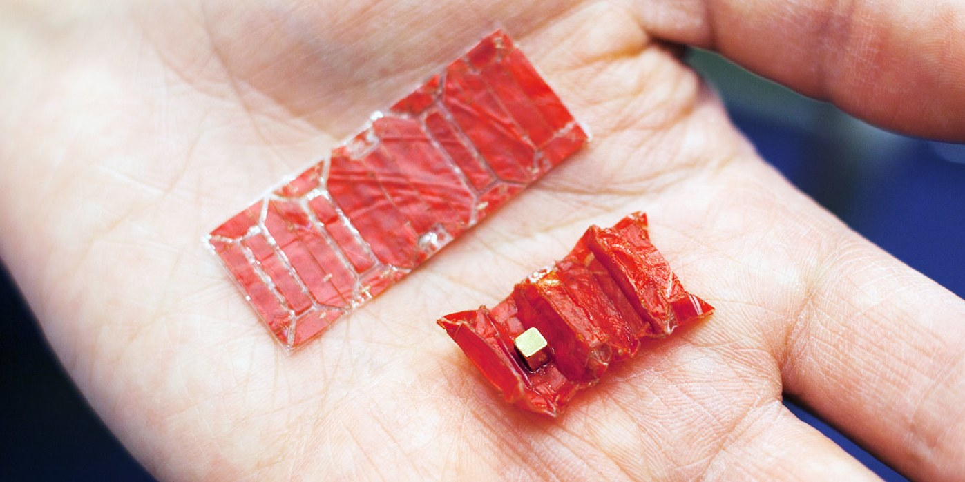
Need of Ingestible robot
Every year, 3,500 swallowed button batteries are reported in the U.S. alone.
Frequently, the batteries are digested normally, but if they come into prolonged contact with the tissue of the esophagus or stomach, they can cause an electric current that produces hydroxide, which burns the tissue.
Most of the parents have faced horrors of children swallowing buttons or other harmful items which are sometimes nearly impossible to extract unless operated and cut open.

Slide 5
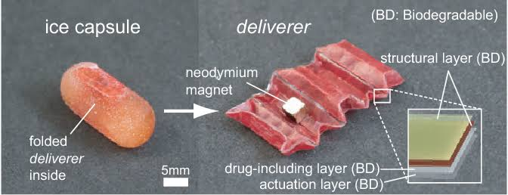
Construction
It consists of layers of structural materials with different heating properties which determine how the robot shall behave in a given condition.
It also partially relies on thrust motion of stomach for proper movement.
The robot’s flexible frame is biodegradable.

Slide 6
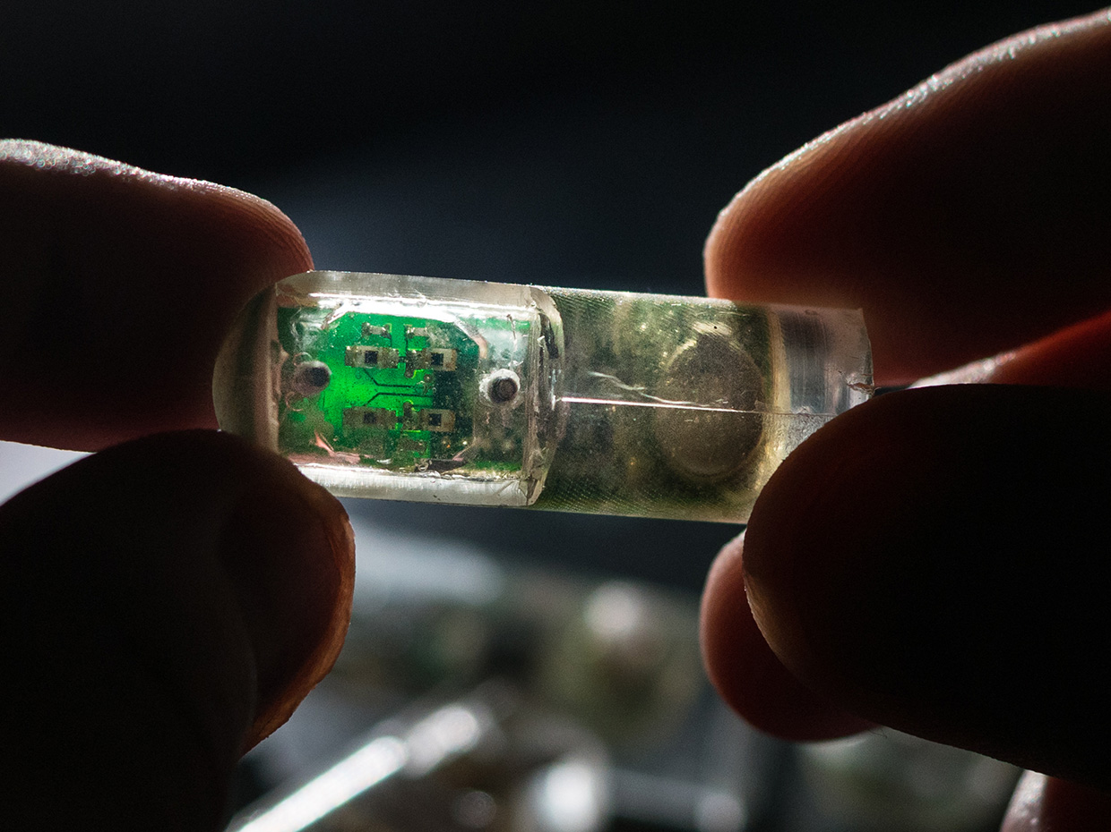
Allowing the robot to slip and crawl through the stomach on the way to the object it is trying to retrieve or the wound where it must deliver drugs because the stomach is filled with fluids, the robot doesn’t rely entirely on stick-slip motion.
Magnetic forces control its movement. Researchers use remote-control joysticks to change the magnetic field

Slide 7
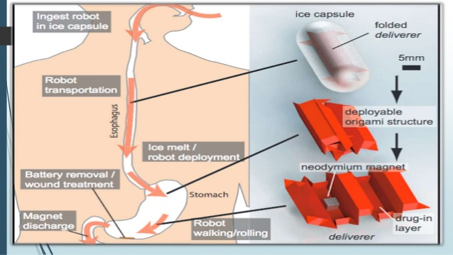
working
The center of one folds is a permanent magnet that responds to changing magnetic fields outside the body, which control the robot’s motion.
The forces applied to the robot are principally rotational.

Slide 8
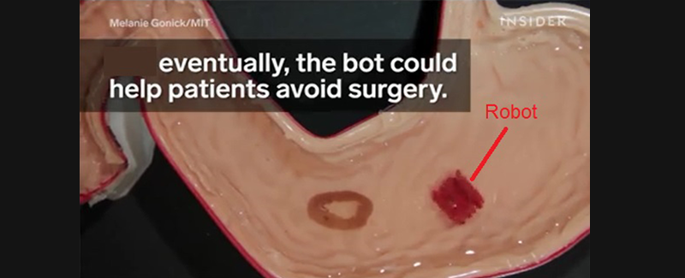
mission of robot
Rus Sir said one of the robot’s most important missions could be to save the lives of children who swallow the disc-shaped button batteries.
The robots could seek out and capture the battery before it causes too much damage, pushing it down through the gastrointestinal tract and out of the body.

Slide 9
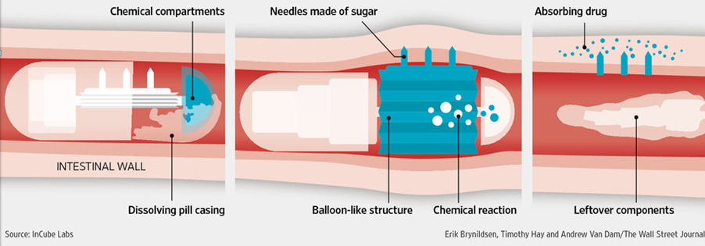
ByPassing the syringe
A pill developed by Rani Therapeatics is designed to safely inject drugs in the small intestine. Protein based terapeutics usually need to be injected because the stomach will break down before they can reach the blood steam and benefit the patient.

Slide 10
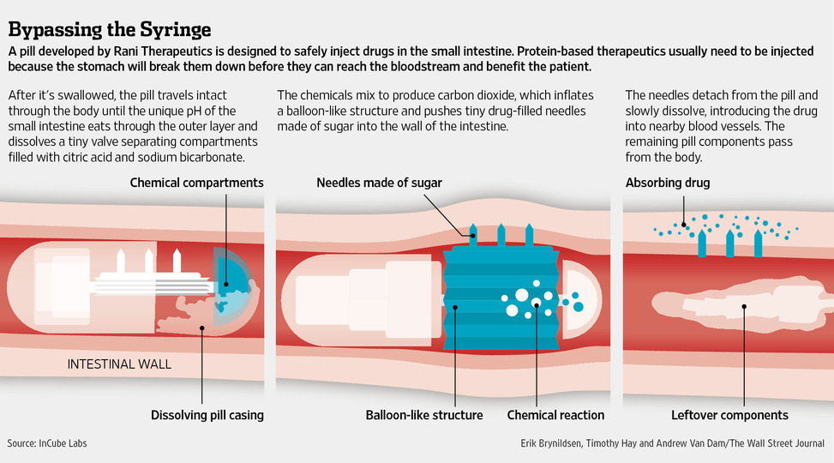

Slide 11
APPLICATIONS
One of them is the removal of button batteries, a common complaint found in children. Current surgeries recommended are endoscopy or bronchoscopy (although minimally invasive, they still cut you up, and are sometimes painful)
It can also help to deliver medicines to target areas, especially important for cancer therapy
Most of all, it can help in bariatric surgeries, where typically one needs to open patients’ abdomen from navel to diaphragm.

Slide 12
Advantages
It can be easily swallowed, moves smoothly by external magnetic fields.
Ingestible robots can treat any injury from inside, as it works in acidic environments.
It can also help to deliver medicines to target areas, especially important for cancer therapy, where current general chemotherapy kills healthy cells along with cancerous cells despite precautions.
Targeted drug delivery can one day help to nullify only the metastasizing cells responsible for cancer.

Slide 13
disadvantages
Difficult to control and place a robot inside the body if the robot is attached to a tether.
Therapy is very expensive, slow and complex.
It cannot carry large objects.

Slide 14
conclusion
Origami robot designs are well suited for tasks that require multiple modalities of locomotion, such as traveling through the esophagus and the stomach.
Because they can do the first task in a compact shape (e.g. a pill shape) and then morph to enable a solution for the second task.
We believe that these techniques for creating origami robots provide a non-invasive method for clinical interventions.

Slide 15
references
Author name: John Pavlus , Title : Ingestible robot perform surgery from inside the body , December 2016 URL : https://www.scientificamerican.com/article/ingestible-robots-perform-surgery-from-inside-the-body/
Author name: Matt O’Brien , Title :Ingestible robot to battle health concerns, July 19 ,2016 . URL : http://www.ctvnews.ca/health/researchers-designing-ingestible-robot-to-battle-health-concerns-1.29924
Author name: Med tech Luther, Title : A new milestone in the robotics “Ingestible robot”, August 28, 2018 URL: www.medicalnewstoday.com/articles/310250.php
http://www.gazettenet.com/MIT-researchers-design-ingestible-robot-3562620
http://fortune.com/2016/02/24/robotics-market-multi-billion-boom/
https://designtoimprovelife.dk/ingestible-origami-robot/
https://www.gazettenet.com/MIT-researchers-design-ingestible-robot-3562620

Slide 16


