Slide 1
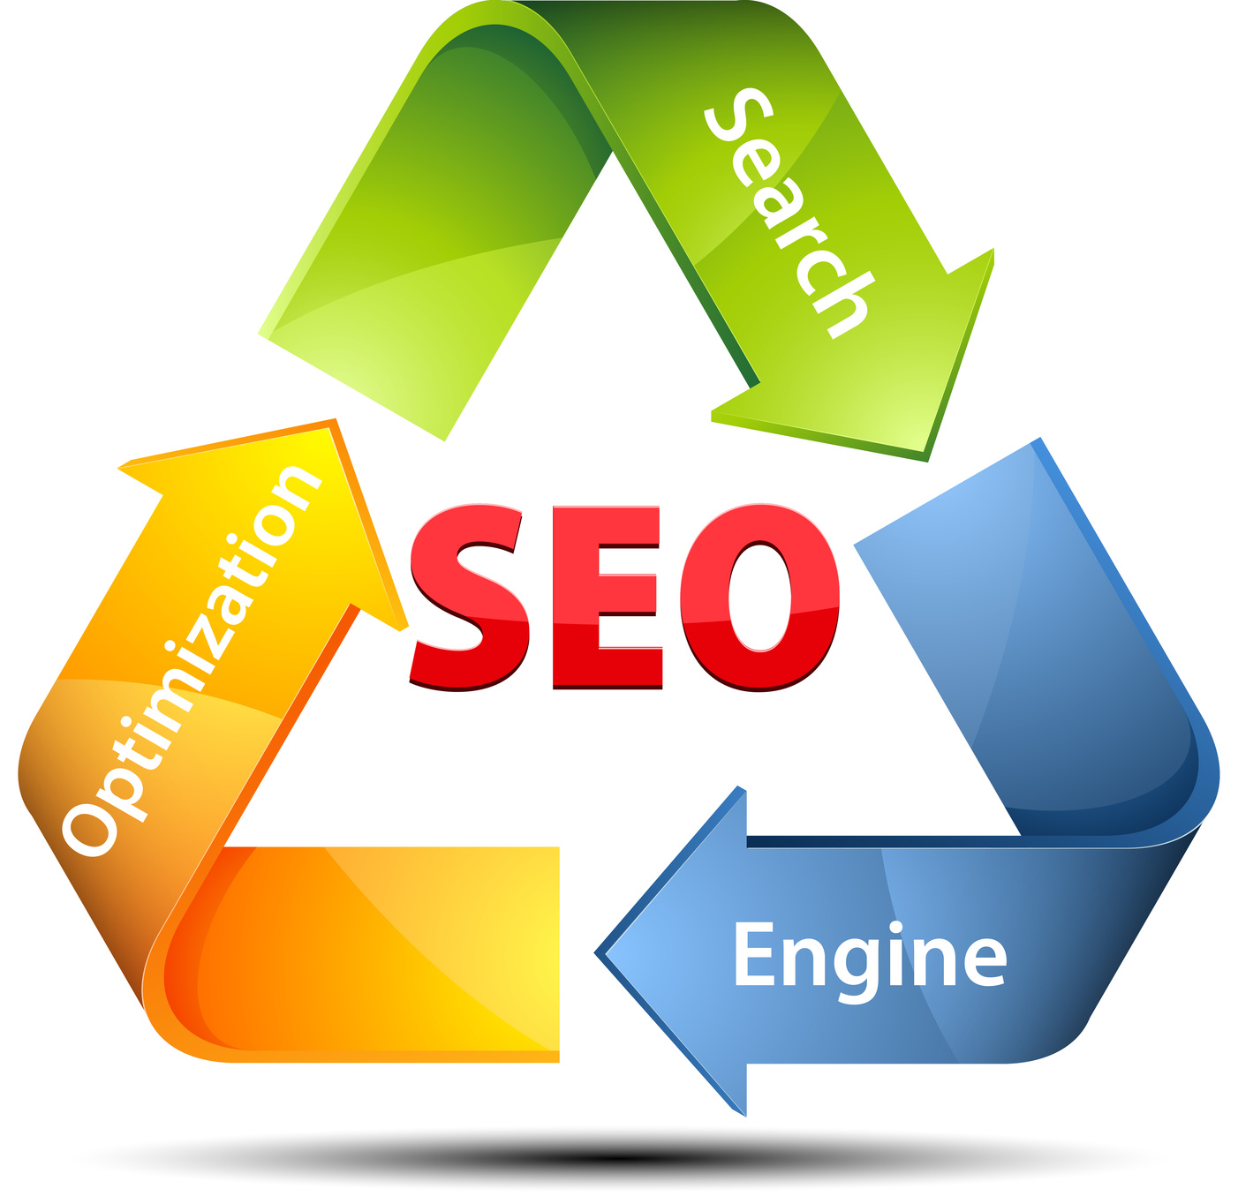
SEARCH ENGINE OPTIMIZATION TECHNIQUES

Slide 2
Contents
Why SEO is needed?
Introduction to SEO
How Search Engine works?
Techniques used for SEO
Types of SEO
Advanced SEO Techniques
Benefits Of SEO
Future Of SEO
Conclusion
References

Slide 3

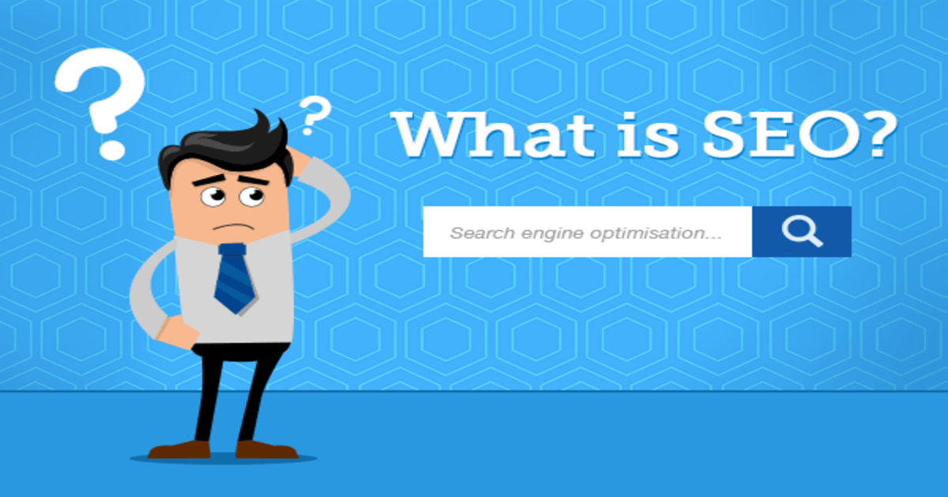
Why SEO is needed ?

Slide 4

Introduction to SEO
SEO stands for Search Engine Optimization.
Search Engine Optimization is a process of improving ranking of web-page for relevant keywords.
SEO is all about optimizing a website for Search Engine.
SEO is to improve the volume and quality of traffic to a website from search engine.

Slide 5
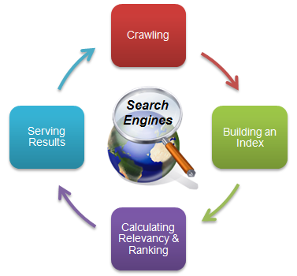
How Search Engine Works?

Slide 6
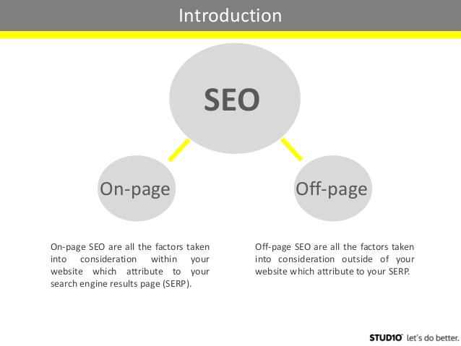
Techniques used for SEO

Slide 7
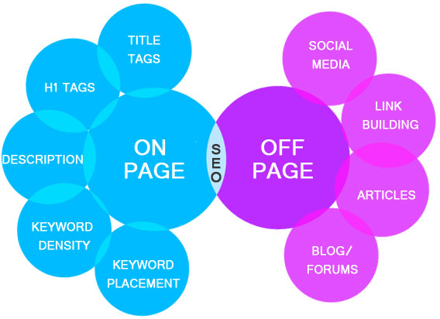
On Page and Off Page Optimization

Slide 8
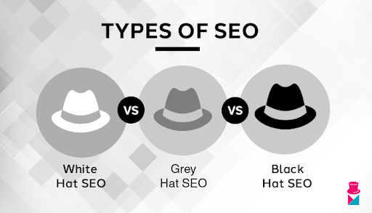
Types of SEO

Slide 9
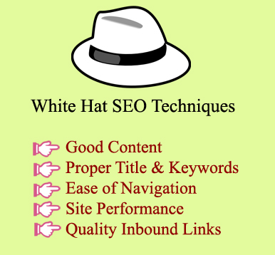
White Hat SEO
White hat SEO refers to the usage of optimization strategies, techniques and tactics that focus on a user and completely follows search engine guidelines and policies in.

Slide 10
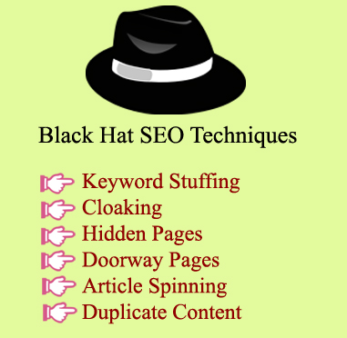
Black Hat SEO
Black hat SEO refers to the usage of combative SEO strategies, techniques and tactics that concentrate only on search engines and not on users, and usually does not obey search engines prototype.

Slide 11

Grey Hat SEO
Grey hat technique is somewhere between of white hat and black hat.
Grey hat approach can be used only when we are sure about all the tactics and the way it should be used otherwise it could lead to malfunctioning.
It consists of techniques such as
  Cloaking
  Old Domains
  Duplicate Contents
  Purchasing Links
  Social Media Automation and Buying Followers

Slide 12
Advanced SEO techniques
Focus On What Your Target Audience Wants
Use More Infographics
Use Appropriate Tags For Visual Content
Optimize Your Website For Mobile Device
Improve Your Page Loading Speed
Improve Your Content For Voice Searches
Create Good Website Architecture

Slide 13
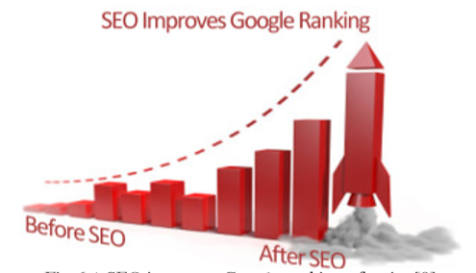
Benefits of SEO
The primary benefit of SEO is you can be ranked up in top 10.
SEO helps to increase the traffic on the website and leads to higher sales for your business.
When your site is ranked up, the return of investment becomes greater as you get a lot of free traffic for your website.
SEO is a cost effective way of marketing.

Slide 14
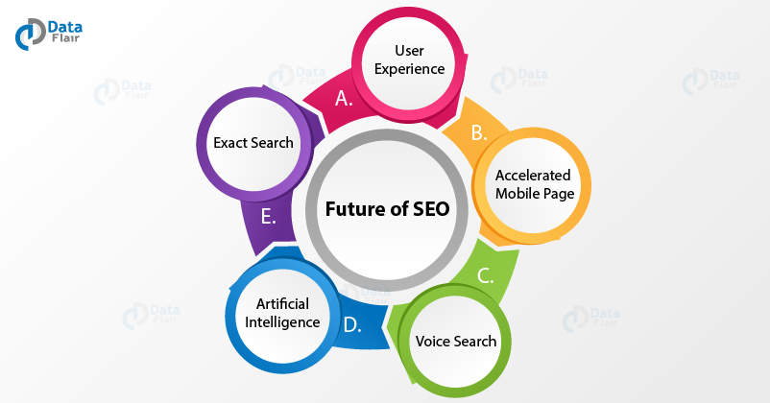
Future of SEO

Slide 15
Conclusion
Search engine optimization is the best process to attract the internet users and gain traffic to a website.
It is also useful in positioning a site to the top level in the search engine result page.
The different techniques help the web site designers and promoters to make their site’s visible to the search engine.
If all these techniques are followed in a correct manner the web site will be promoted among a vast range of people and the return on investment for the site would also be high.
Search engine optimization is an effective practice when it is followed correctly.

Slide 16
References
http://en.m.wikipedia.org>wiki>Search_Engine_Optimization
http://www.webconfs.com/SEO-tutorial/introduction-toSEO.php
Najam Nazar: Exploring SEO Techniques for Web 2.0Websites, Department Of Computer Science and Engineering Chalmers University of Technology Göteborg,Sweden, June 2009, Publikationen registrerades 2009-08-25. Den ändrades senast 2013-04-04, Examiner: C. Carlsson.
Duk, S. , Bjelobrk, D., Carapina, M., “SEO in e-commerce: Balancing between white and black hat methods.
Renyuan Wang , Yan Chen , Taoying Li , Yingying Yu, “The Optimization of
Search Engines Ranking Technology Based on Grey System ”Computational
and Information Sciences (ICCIS), 2013 Fifth International Conference.
http://proranktracker.com>blog>advanced-seo-techniques-2019

Slide 17
Thank You!

