Slide 1
Virtual Personal Assistant
(VPA)

Slide 2
Contents
Introduction
Hardware and Software requirement
Working
Features
Applications
Advantages
Disadvantages
Future Scope
Conclusion
References

Slide 3

Introduction
What is Virtual Personal Assistant?
A virtual personal assistant is an application program that understand
the natural language and complete the electronic task for end user.
Virtual personal assistant are the best fit if you are looking for the things
that include scheduling meetings , booking , sending invoices checking
up the emails , making copies , etc.
Virtual Personal Assistant are remote
assistant which work for a particular
person.

Slide 4
Hardware and Software requirement
Hardware
A phone with a touch screen interface.
Internet connectivity.
Software
Operating system should be android 4.1/Win 8.1 higher.
Support of basic application like calendar , camera , web connection , etc.

Slide 5
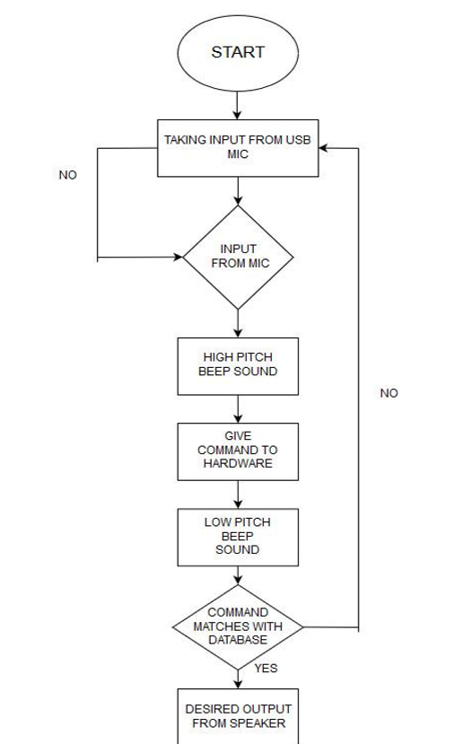
Working
The working of the system is done according to the
Steps shown in diagram:
Any Virtual Assistance basically consists
of two types.
Speech processing ( Speech to Text conversion )
Text to Speech conversion

Slide 6
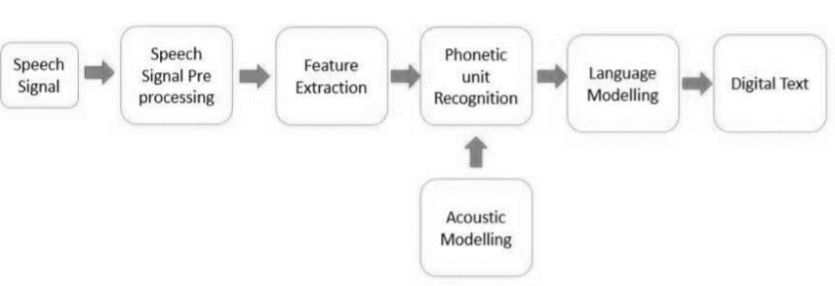
Working
Speech processing ( Speech to Text conversion )
  A piece of software used that converts audio to text.
  As we know speech is a time-varying signal so we need to perform
  windowing method for extraction of signal from speech signal as we
  can see from Fig.
  Speech signal consist of voiced and unvoiced signals.

Slide 7
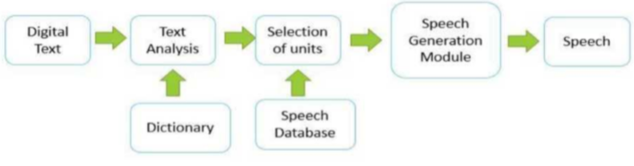
Working
Text to Speech conversion
It takes input in the form of digital text and gives the output in
voice format.
The output in voice format is played on the speaker.

Slide 8
Features
Some of the features of Virtual Assistant, you may ask him in day by day
uses are shown below:
  Make Phone Calls
  Schedule meetings & Appointments
  Get Direction
  Send Messages
  Set Remainders
  Ask Questions
  Play Music & Videos
  Wake me up at 6.30AM

Slide 9
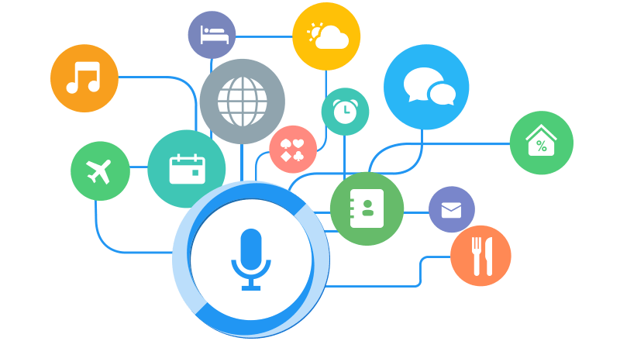
Applications
Amazon Alexa
Google Assistant
Cortana
Tetra

Slide 10
Advantages
Save Money
Save Time
Use Virtual Assistant as Needed
Increase Productivity and Avoid Burn Out

Slide 11
Disadvantages
Listening problem
Internet access

Slide 12
Future Scope
Next step will be to strip back the physical hardware as far as possible.
With the intelligence of the VA it is pushing its way into our lives on multiple
devices on our bodies and in our offices, homes, and vehicles.
Your VA will be continually prompting you with suggestions and taking
Instructions, and will know more about you than perhaps you do yourself.
We can expect this device to be implanted and permanent.

Slide 13
Conclusion
Virtual Personal Assistants are very effective way to organize your
schedule. Now there are many Smart Personal Digital Assistant applications
available in market for various device platforms.
These new Software Applications are performing really well than
devices as they provided with all resources of your Smartphone.
VPAs are also reliable than Human Personal Assistant because,
VPAs are more portable and you can use them anytime. They also have lot
of information than any assistant as they are connected with internet.

Slide 14
References
Digital Personal Assistant for the Enterprise2013 Intel White Paper.
Comerford, L, Frank, D, Gopalakrishnan P, Gopinath R and Sredivya J. 2001
The IBM Personal Speech Assistant Acoustics,
Speech, and Signal Processing Proc. of International Conference on Speech
and Signal processing, 1 1-4.
Zwass, Vladimir (2016-02-10). "Speech recognition | technology".
Encyclopædia Britannica Online. Britannica.com.
Retrieved 2017-12-10.
Paul Taylor 2007, Text-To-Speech Synthesis University of Cambridge pp
45-56.
Tom M. Mitchell 1997, Machine Learning, McGraw Hill pp 88-92.

Slide 15


